Slide 1
Output
Automation login and registration

Slide 2
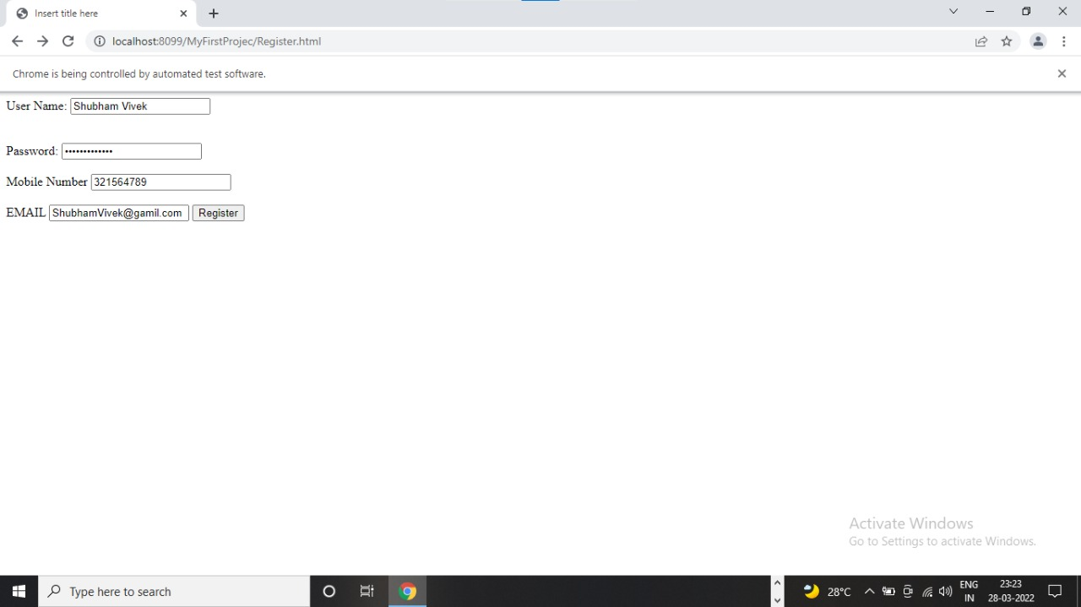

Slide 3
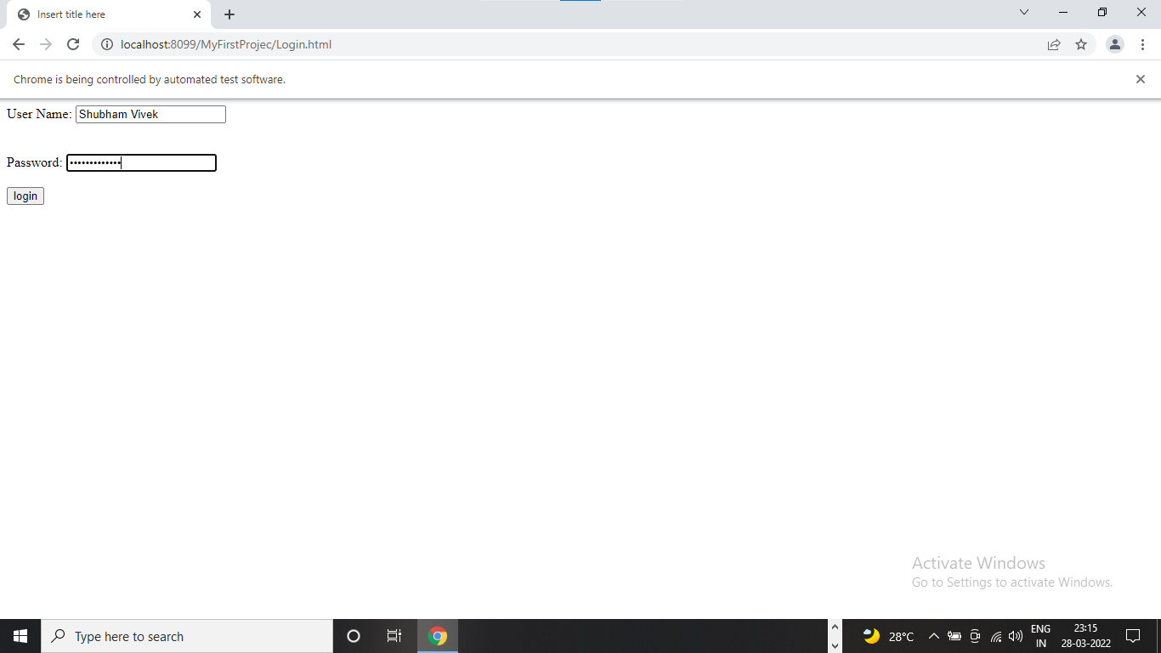

Slide 4
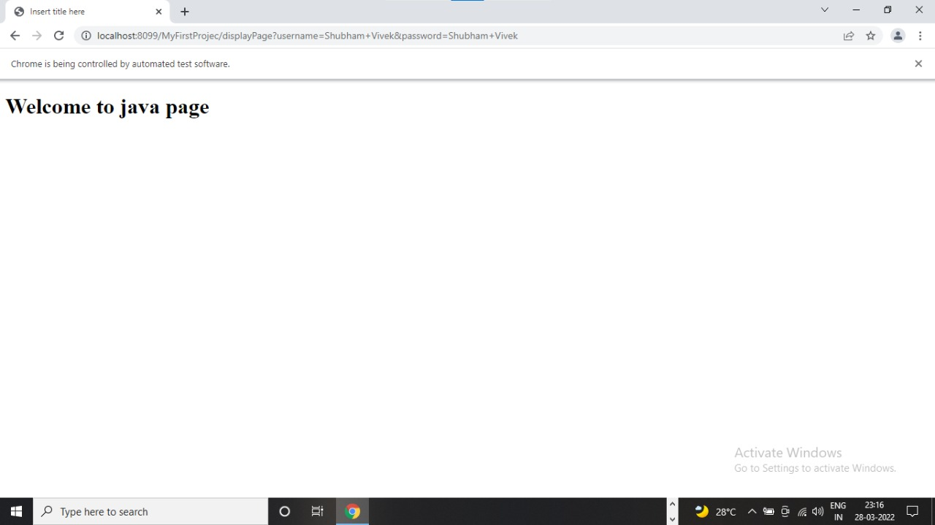

Slide 5
ThankYou

